Slide 1
R Notebook

Slide 2
this plot is about baseline change

Slide 3
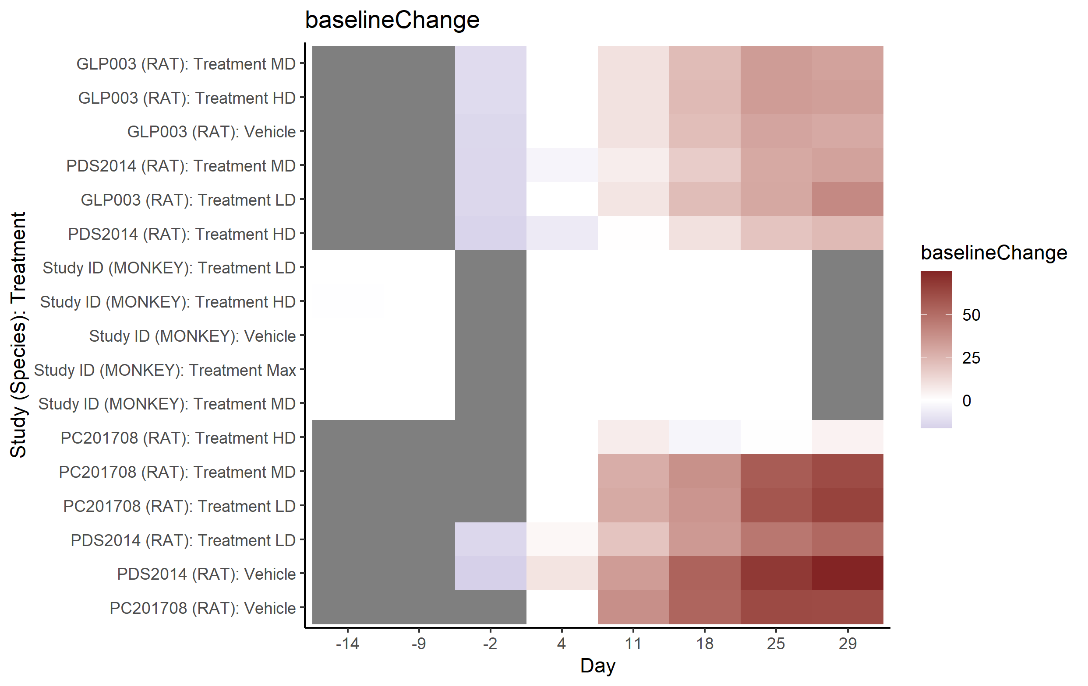

Slide 4
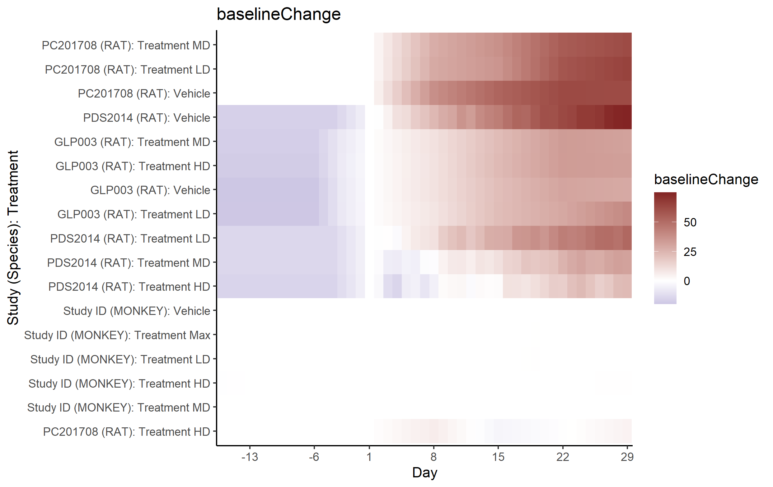

Slide 5
